Slide 1


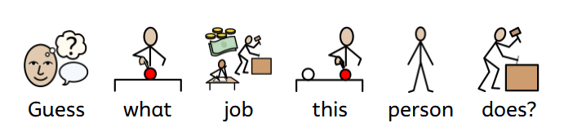
Careers
Topic: Superheroes

Slide 2
This example if from Autumn 1 Cycle A
It focuses on Everyday heroes
The structure is here to adapt by the class lead for their specific class. This might not be the finished approach for each class.
This first slide - our hook - gathers student interest - a guessing game based on the picture alone!
Careers
Topic: Superheroes

Slide 3
Careers
Topic: Superheroes
Job: Office Assistant

Slide 4
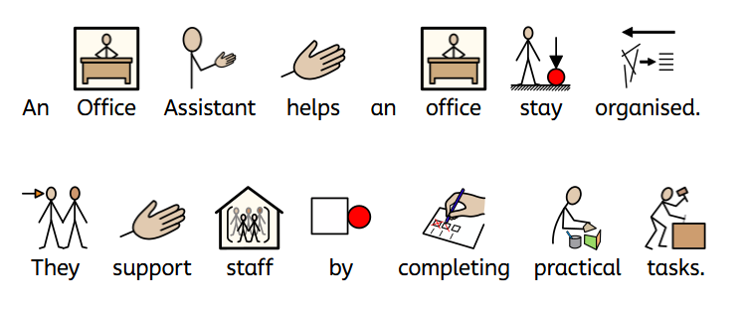
Careers
Job: Office Assistant
What do they do?

Slide 5
Using the same picture, simple ‘widget’ sentences describe the basic function of the job.
The language is simple, but this may need further adaptation by the class lead for some classes.
Description of the job runs over two slide
Careers
Job: Office Assistant
What do they do?

Slide 6
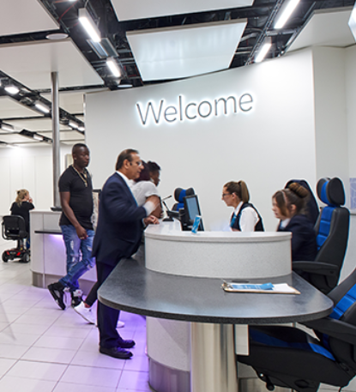
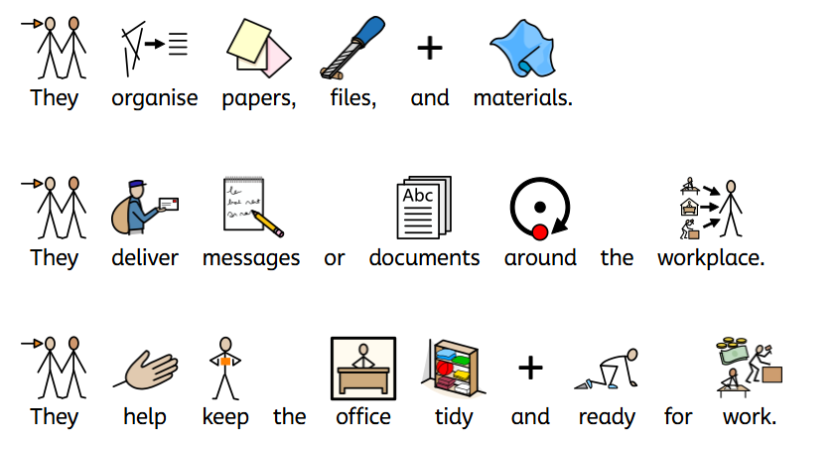
Careers
Job: Office Assistant
What do they do?

Slide 7
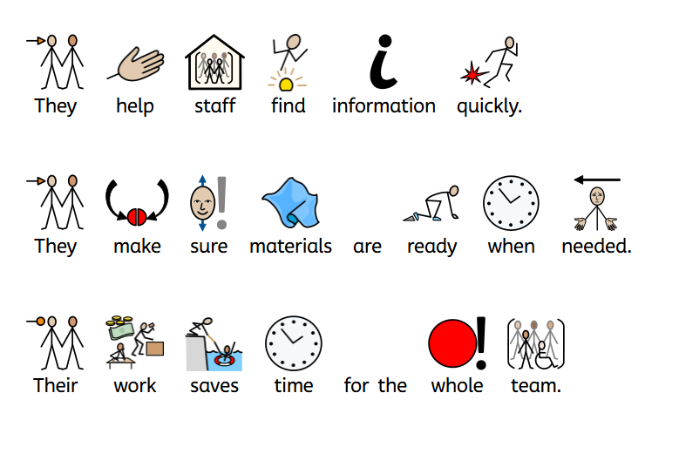
Careers
How can this help me?

Slide 8
The pictures vary, which might prompt further discussion – class leads are encouraged to ask questions that relate to how this job impacts on others (or them)
Careers
How can this help me?

Slide 9
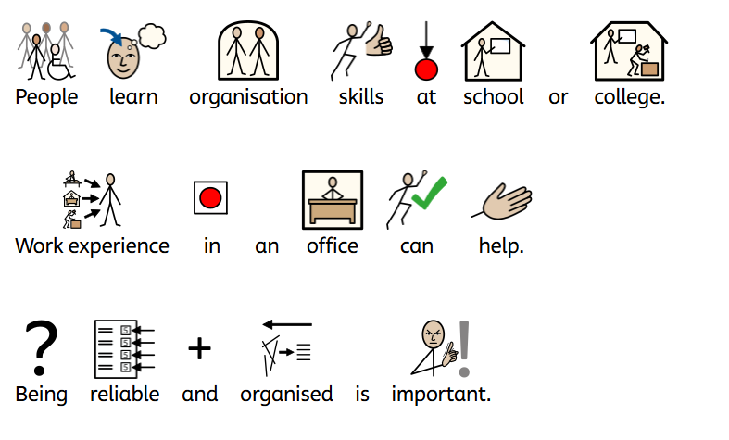

Careers
How do people become a…

Slide 10
This slide is a starting point for possible greater discussion about routes or pathways into this job.
It deliberately starts to focus discussion on skills.
Careers
How do people become a…

Slide 11
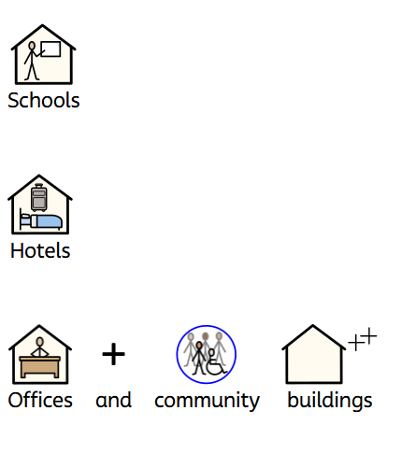
Careers
Where might you see someone doing this job?

Slide 12
Students might want to provide examples of where they have seen individuals perform this job from their own personal experiences.
Careers
Where might you see someone doing this job?

Slide 13
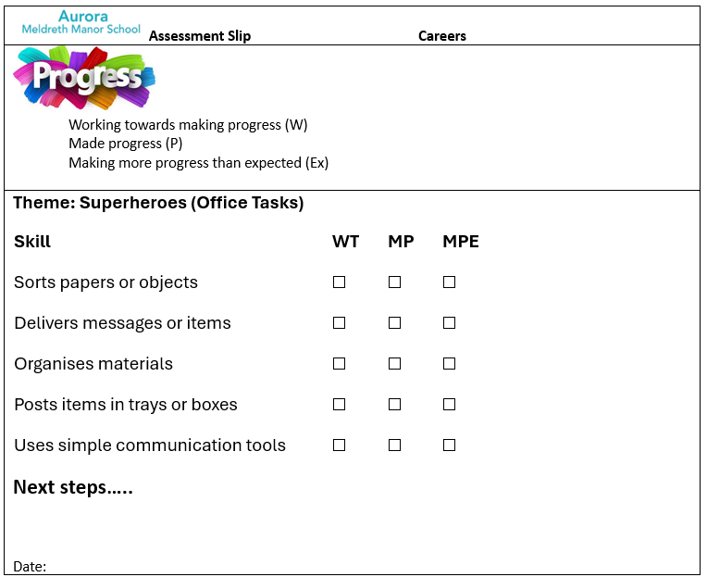
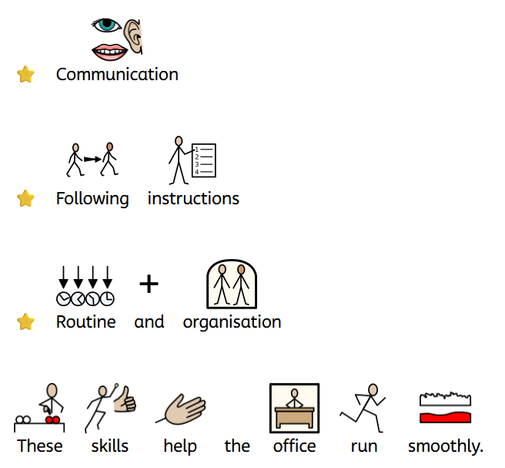
Careers
How do you use similar skills?
Skills used in this job.

Slide 14
This slide focuses on similar skills that students can demonstrate over this half term.
This creates a meaningful link to Jobs and the types of skills one might need.
A ‘Careers’ assessment slip forms part of our Assessment of Careers
Careers
How do you use similar skills?
Skills used in this job.

Slide 15
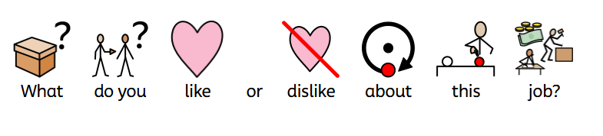
Careers
Job: Office Assistant

Slide 16
This final slide offers opportunity to explore the diverse views from the class about this job.
All ‘Job of the week’ PowerPoints follow this same predictable format
Careers
Job: Office Assistant

